Slide 1
Webinar: Climate change and health project ideas for GCF
3 - 4 March 2020
Corey Fortin, Asia Pacific Regional Officer (cfortin@gcfund.org)
Bolormaa Enkhbat, Asia Pacific Regional Officer (benkhbat@gcfund.org)

Slide 2
A BRIEF HISTORY
Initial Strategic Plan
Updated Strategic Plan*
Initial Resource Mobilization Period
GCF – 1 ($9.77b pledged)
Established at COP16
First Board Meeting
First Projects Approved
2019
2010
2011
2012
2014
2015
2020
2023
Governing Instrument
USD 10b+ pledged for IRM
123 Projects
$5.4B committe
95 Accredited Entities
100+ countries reached
*Strategic Plan for consultation of the GCF Board at B.

Slide 3
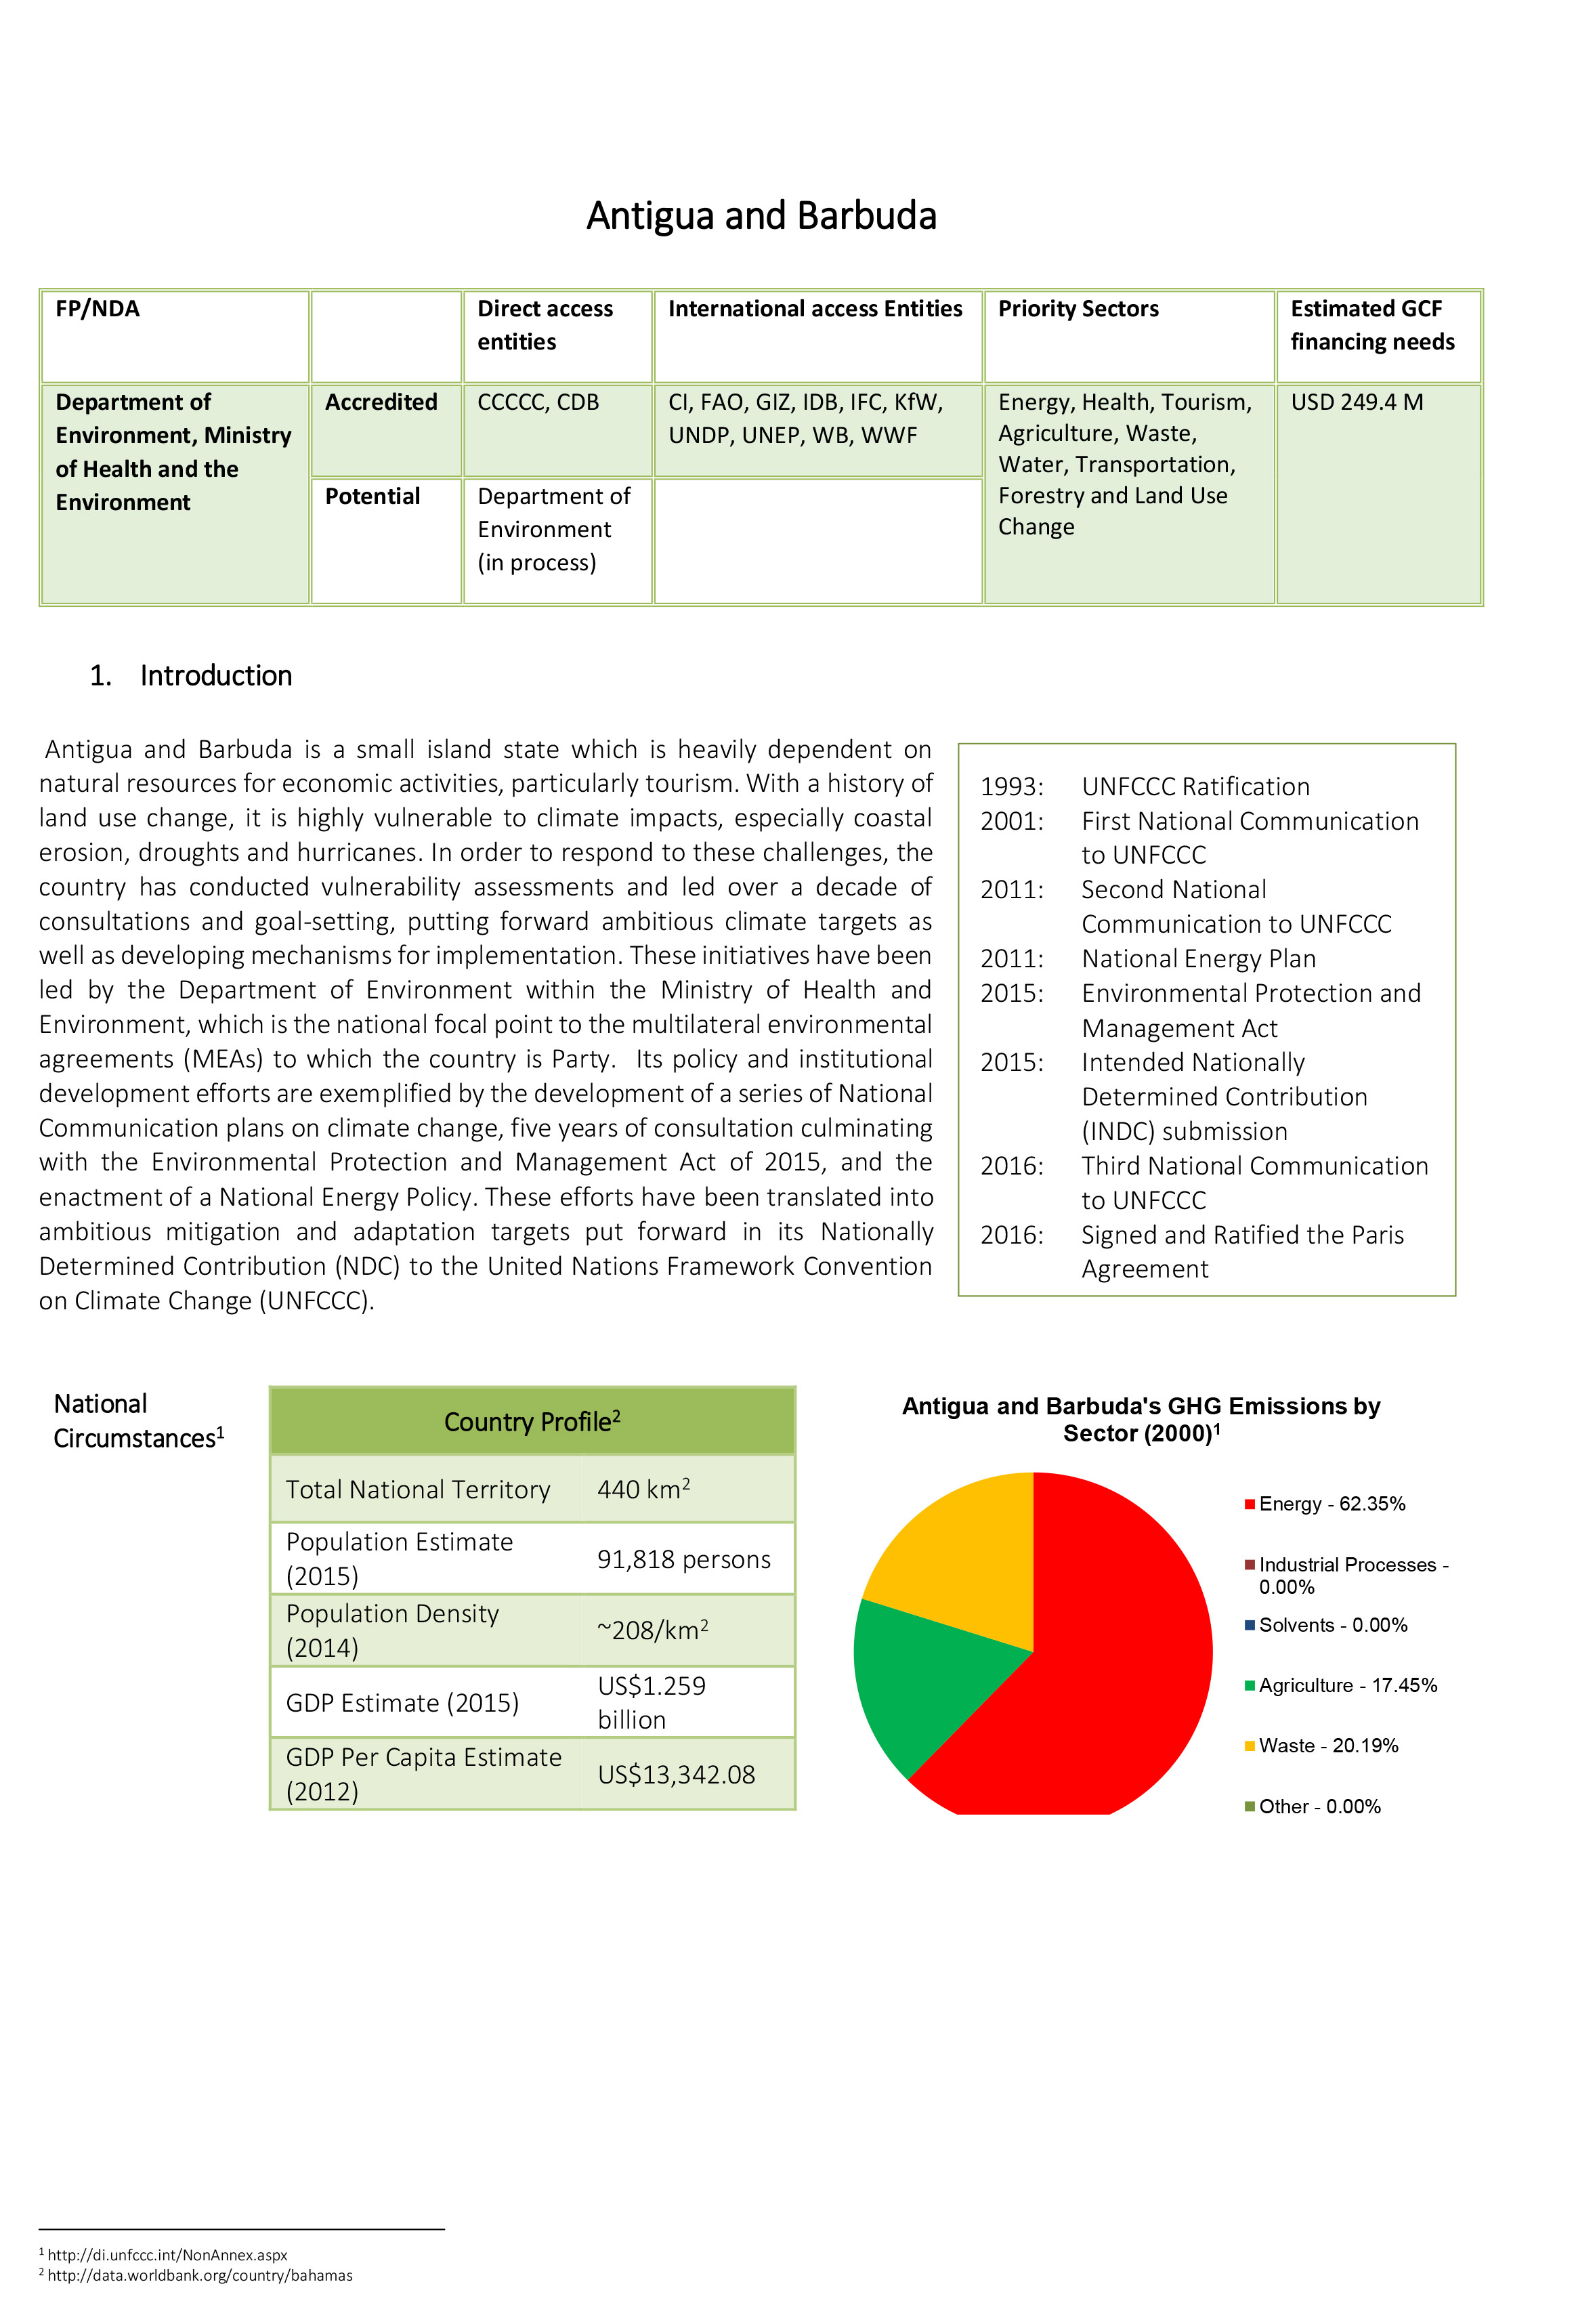
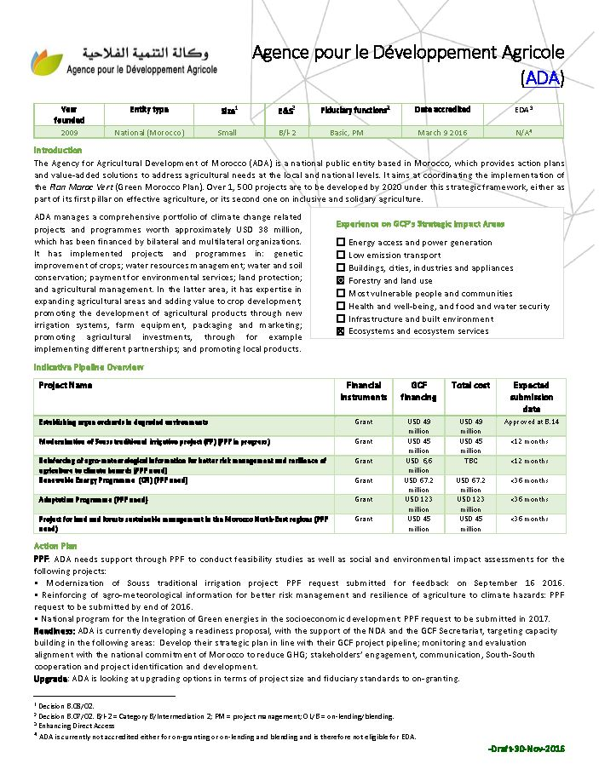
Programming with GCF
Today’s Focus
COUNTRY & ENTITY
PROGRAMME
READINESS (including adaptation
planning)
FUNDING PROPOSALS
PROJECT CONCEPTS
PPF
NDCs
NAPs
LEDS
Project Concept Notes
Country and Entity Programmes are the foundation for developing project proposals
Structured programming dialogues support identification of transformational projects
What sectors,
what projects
are a priority
for the country?
Are there any gaps
for identifying or
strengthening
entities?
Which entity(ies)
is the most suitable to
deliver the pipeline?

Slide 4
Readiness Programme (AS OF March 3, 2019)
370
230.9
265
76
142
GLOBAL
USD million
USD million
USD million
USD million
Total number of readiness grants approved
Total value of readiness grants approved
Total number of readiness grants disbursed
Disbursements
USD 1 million
cap per country per year
USD 3 million
cap per country
NDA and DAE strengthening
Country Programmes and GCF strategic engagement
Access to climate finance
National adaptation plans (NAP) / adaptation planning processes
Notes:
138 countries

Slide 5
What's New in Readiness 2.0?
Multi-Year | NDAs can apply for multi-year readiness up to 3M over 3 years NDAs can still apply for 1-year readiness
Programmatic Focus | Proposals need to clearly illustrate the country’s climate finance landscape (i.e. 5-year plan, INDC, NAP, TNC) and complementarity with other efforts
Objective Areas | Objective areas have been expanded and clarified. This means the outcomes have also changed in the log frame
Template Changes | Baselines, theory of change, capacity assessment/analysis
Internal Changes at GCF – Regional team can help work on co-development prior to review
Consult the readiness guidebook for checklists, best practice examples, quality assurance checklist

Slide 6
Steps of Submitting a Readiness Proposal
Key Points to remember
Stage I: Proposal Development Phase
Begin engaging with relevant government agencies to develop concept
Select Delivery Partner that fits project management needs not necessarily technical needs (Delivery Partner can either be AE or organization that has passed FMCA)
Stage II: Appraisal
GCF Regional Officer will provide early feedback to NDA and DP to help strengthen the proposal and to make sure it is in line with GCF policies and practices
GCF Regional Officer to decide when proposal is ready for appraisal process which consists of an interdivisional review and sent back to the NDA/DP (potentially multiple rounds)
Stage III: Approval
RWG can either endorse or not endorse a proposal. In many cases a proposal is endorse with conditions. The Regional Officers will work with the NDA and DP to address the RWG conditions.
Once all RWG conditions are fully addressed, the proposal is submitted to the Deputy Executive Director for approval (final approving authority)
Familiarize yourself with GCF Readiness template and Guidebook (new one will soon be updated)
Engage with GCF Regional Officer to develop proposal.
After interdivisional review comments are addressed sufficiently, the proposal is submitted to the Readiness Working Group (RWG) for endorsement
Upon approval, GCF will notify the NDA officially and hand over contracting and implementation to UNOPS
Work closely with the NDAs – only they can submit proposals
Work closely with Regional Officers on development of readiness proposals
Start early – on average Readiness proposals can take 6 months from submission to approval
Proposal will be counted towards the cap of the year that it was approved by the GCF (not submitted)
Route communication through institutional focal point for Delivery Partner

Slide 7
Regional Readiness Example Supporting the Implementation of Health-Inclusive Nationally Determined Contributions (NDCs)
Multi-Country | Each country uses part of their annual $1 million cap, and all countries will benefit from the project (i.e. if 5 countries each give 300,000 the regional project would total 1.5 million). Readiness proposal must be led by 1-NDA who submits the proposal and all other participating NDAs need to submit a letter confirming their support and contribution Delivery partner should help to coordinate the readiness proposal idea with the lead NDA as well as other participating NDAs as well as support the proposal development
Example Activities | Conduct national and regional assessments and consultations on NDC enhancement for the health sector Prepare regional health vulnerability assessments and identify financing gaps Strengthen regional direct access entities that have ability to implement health projects Develop regional health and climate change concept notes for submission to GCF/ other climate funds Develop regional health communications strategies
Implementation Arrangements | Regional projects need to carefully consider their implementation arrangements when developing regional readiness, given the added complexity Must engender commitment from each country and develop project structure that works to coordinate and implement activities in all countries

